Slide 1
Martabak Hanjakal created by: Andri Firman Saputra

Slide 2
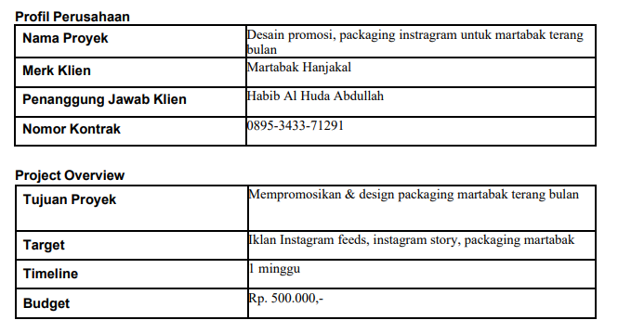
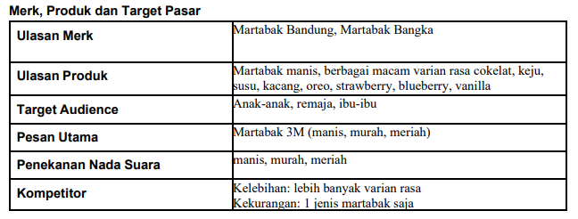
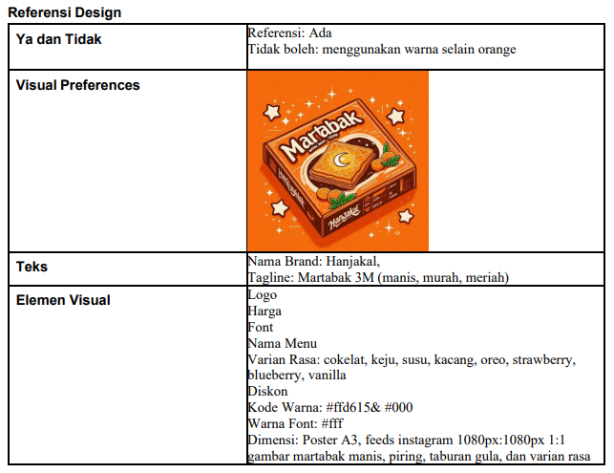
DESIGN BRIEF

Slide 3

DESIGN LOGO

Slide 4
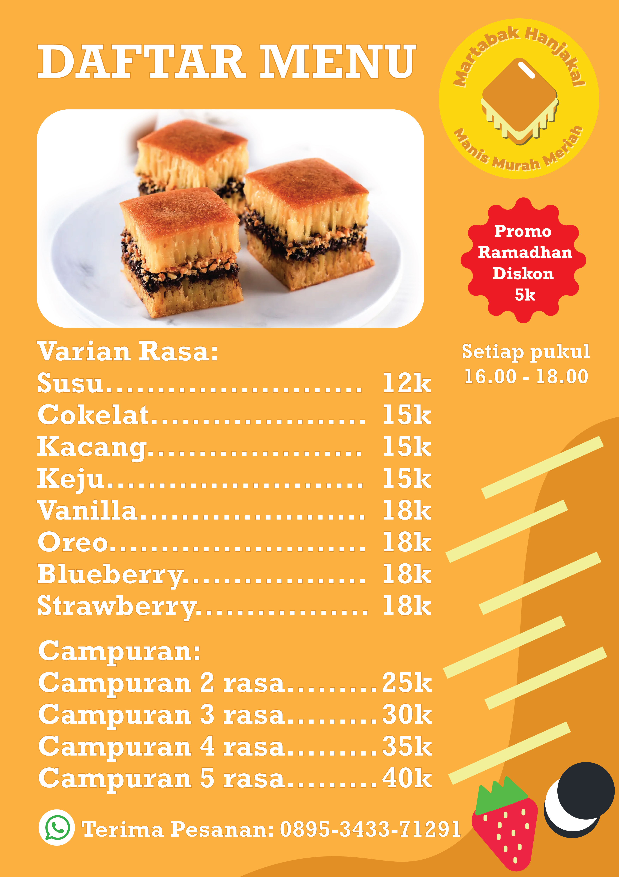
DESIGN FLYER

Slide 5
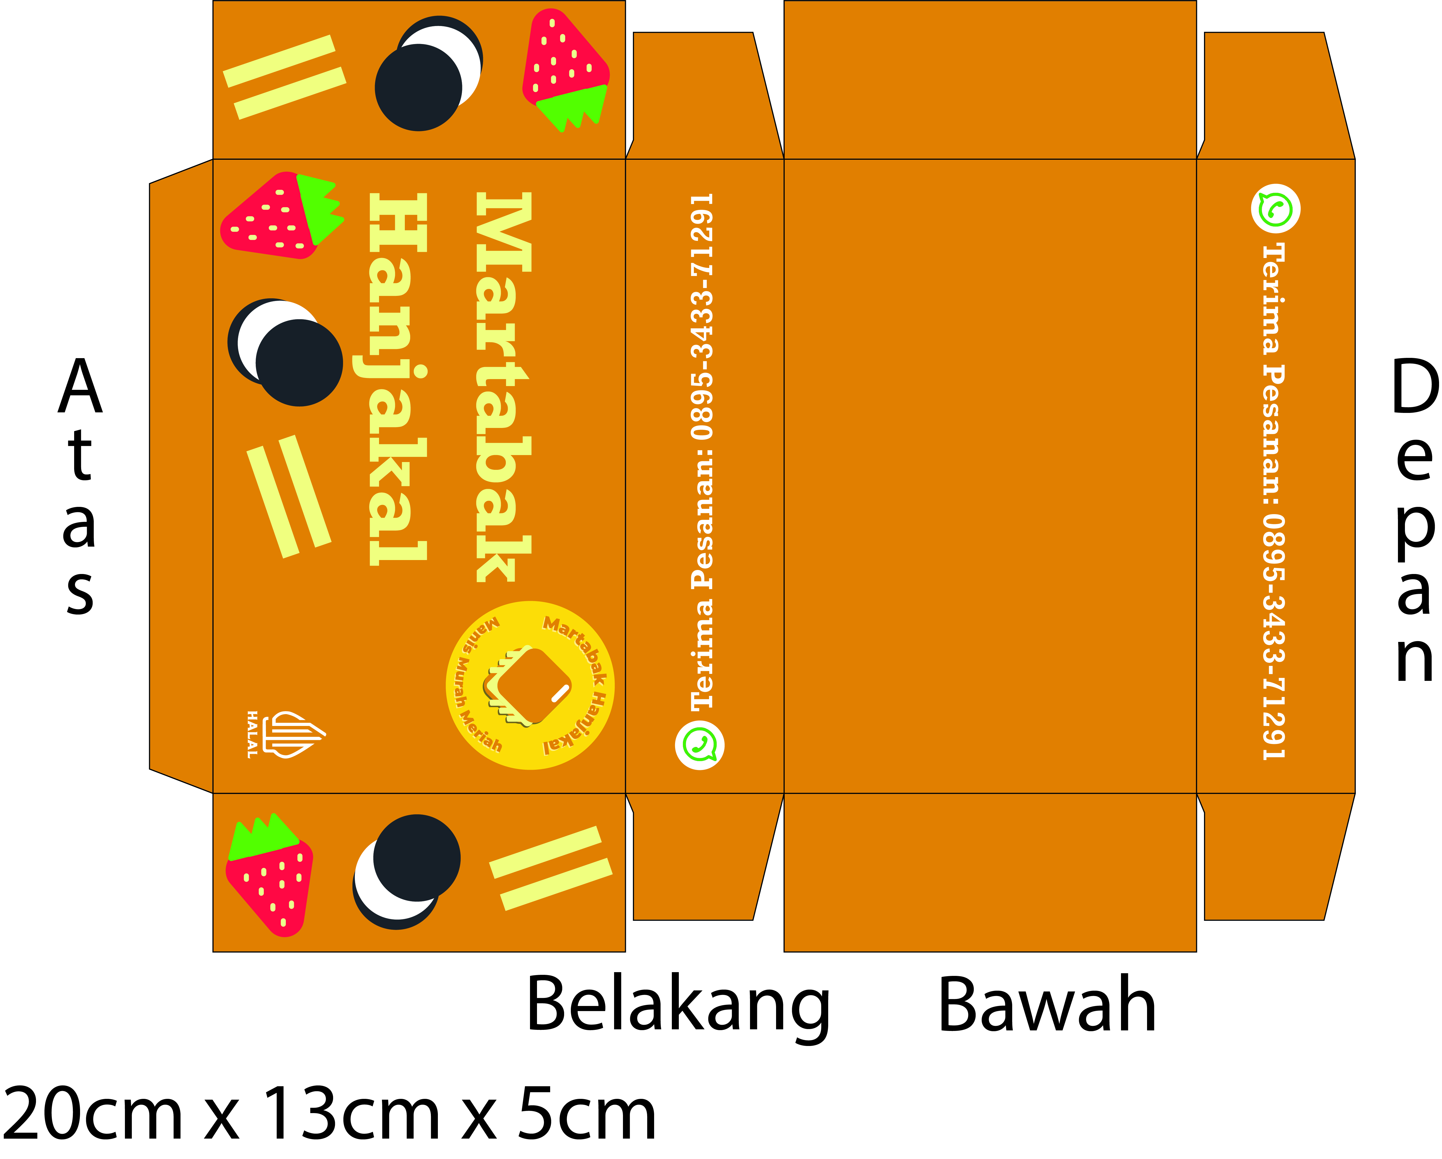
DESIGN KEMASAN

Slide 6
THANKS!

